Slide 1

Business Process Modelling
Prof. Marcello La Rosa
BPM Discipline
Queensland University of Technology

Slide 2

Quick recap from Week 3
What types of gateways there exist?
What are the vocabulary, syntax, semantics and notation of BPMN?
Modelling Language
Vocabulary
Syntax
Semantics
Notation

Slide 3
Information artifacts and resources in BPMN

Slide 4

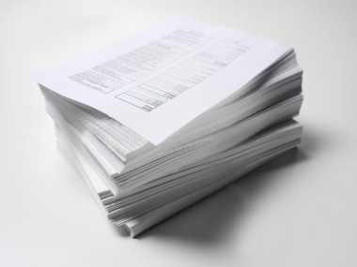


Information artifacts (a.k.a. business objects)

Slide 5
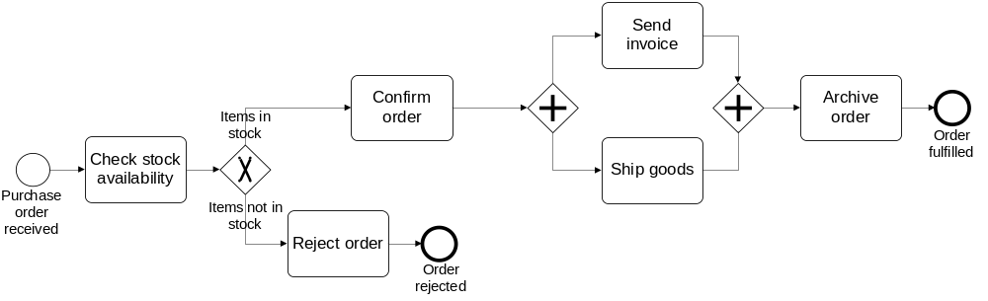
Our Order-to-cash process, again
The purchase order document serves as an input to the stock availability check. Based on the outcome of this check, the status of the document is updated, either to “approved” or “rejected”. If the order is approved, an invoice and a shipment notice are produced.

Slide 6
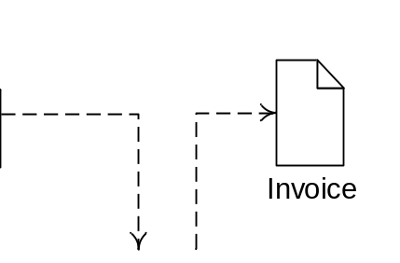
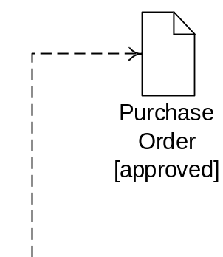
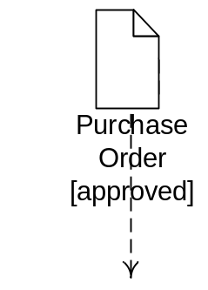
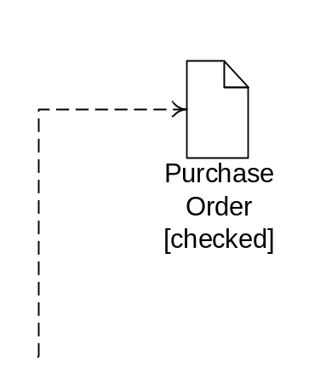
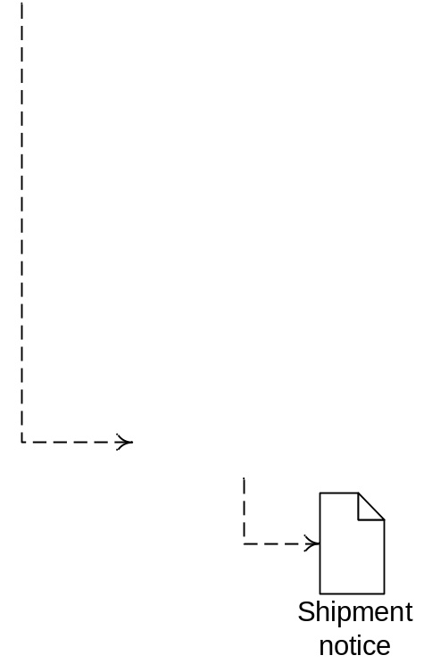
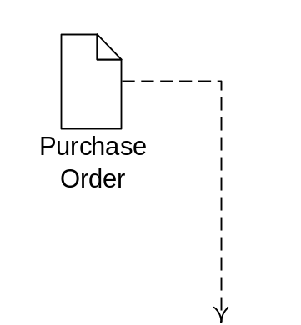
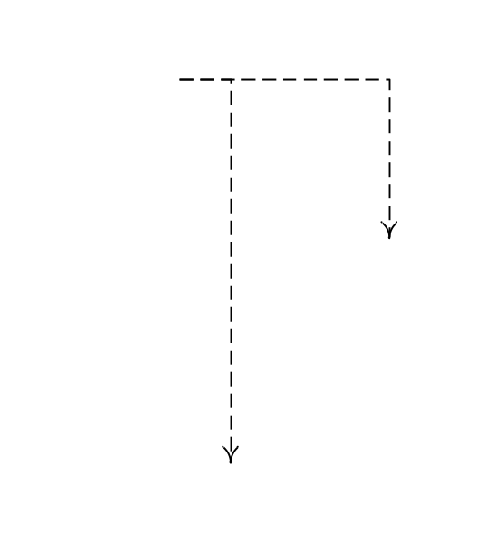
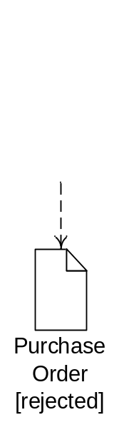
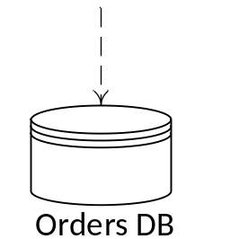
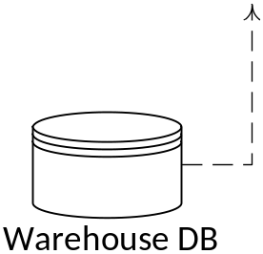
Solution

Slide 7
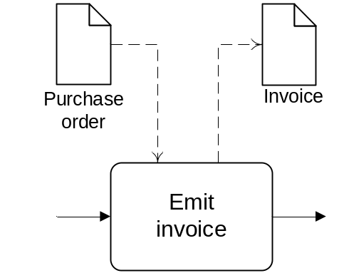
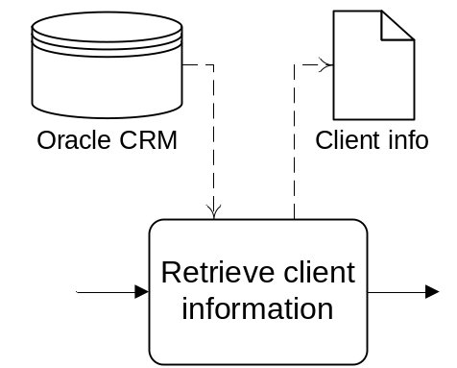
BPMN Information Artifacts
A Data Object captures an artifact required (input) or produced (output) by an activity.
  Can be physical or electronic
A Data Store is a place containing data objects that must be persisted beyond the duration of a process instance.
It is used by an activity to store (as output) or retrieve (as input) data objects.

Slide 8

Do we always need to model data objects?
Do data objects affect the token flow?

Slide 9
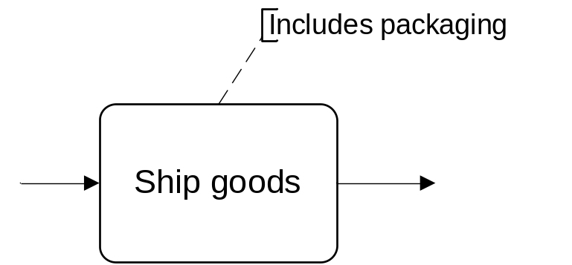
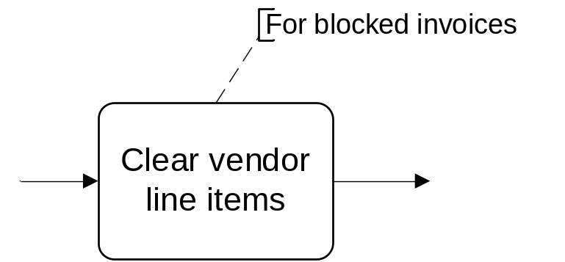
BPMN Text Annotations
A Text Annotation is a mechanism to provide additional text information to the model reader
  Doesn’t affect the flow of tokens through the process

Slide 10

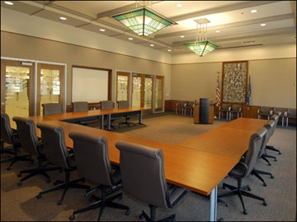


Resources

Slide 11

Resources
Active resources:
  Process participant
  Software system
  Equipment
Resource class:
A group of (active) resources that are interchangeable, e.g. a role, an organizational unit or the whole organization.

Slide 12
Resources in the order-to-cash example
The order-to-cash process is carried out by a seller’s organization which includes two departments: the Sales department and the Warehouse & Distribution department.
The purchase order received by the Sales department has to be checked against the stock. This is done via an ERP module within the Warehouse & Distribution department. If the purchase order is confirmed, the Warehouse & Distribution department ships the goods. Meantime, the Sales department emits the invoice. The process concludes with the order being archived by the Sales department.

Slide 13
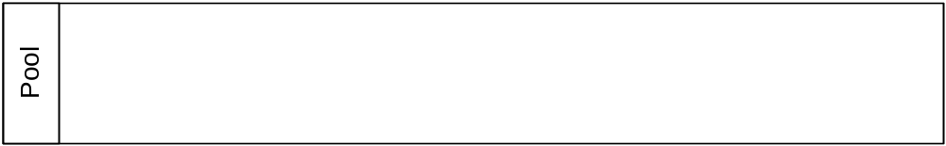
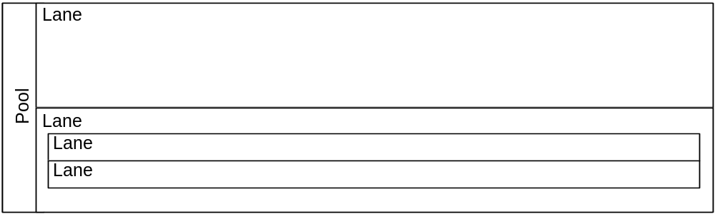
BPMN Elements – Pools & Lanes
Pool
Captures a resource class. Generally used to model a business party (e.g. a whole company)
Lane
Captures a resource sub-class within a resource class by partitioning a pool. Generally used to model departments (e.g. shipping, finance), internal roles (e.g. Manager, Associate), software systems (e.g. DBMS, CRM) or equipment (e.g. Manufacturing plant)

Slide 14
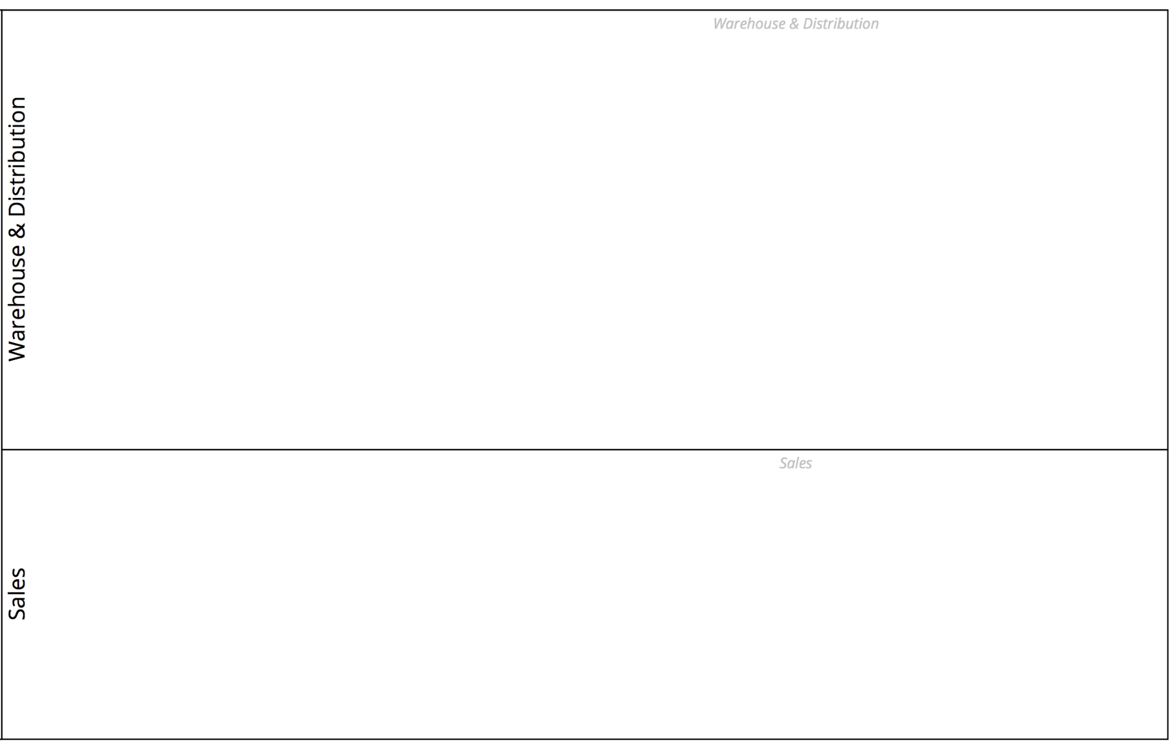

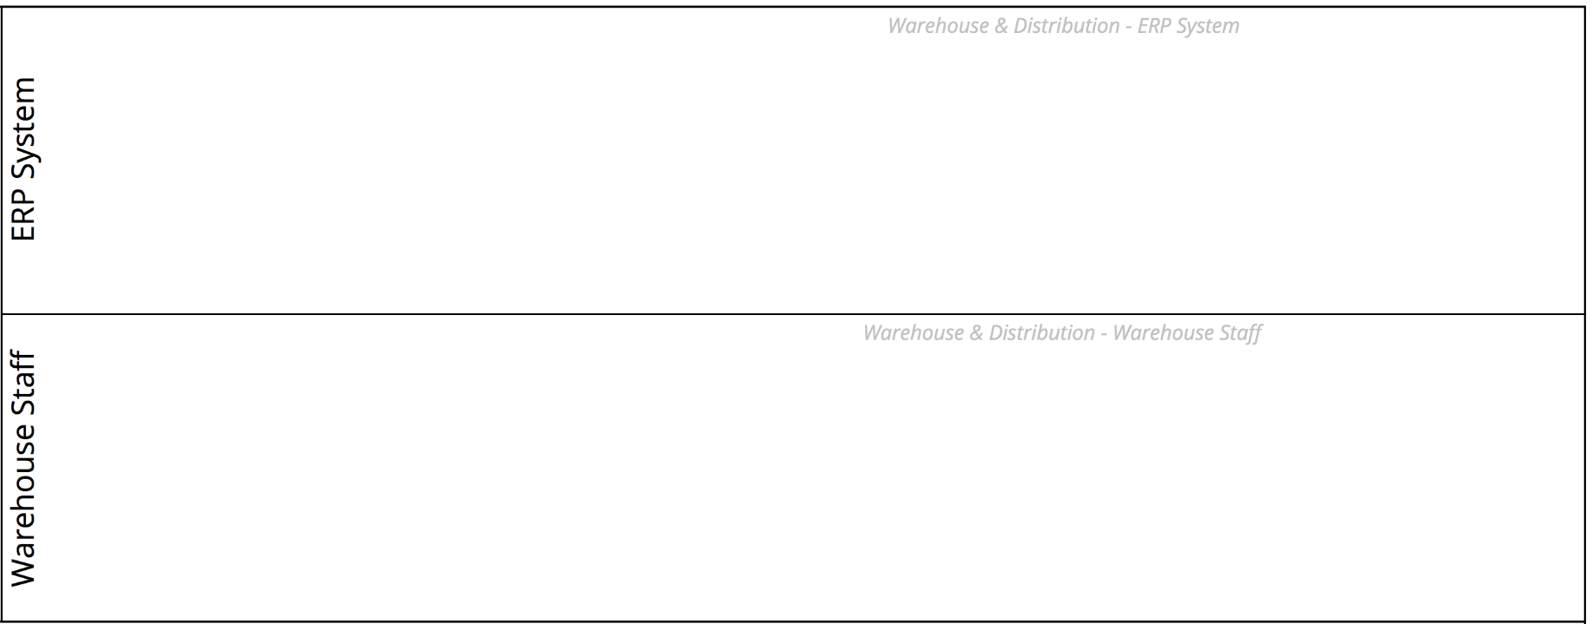
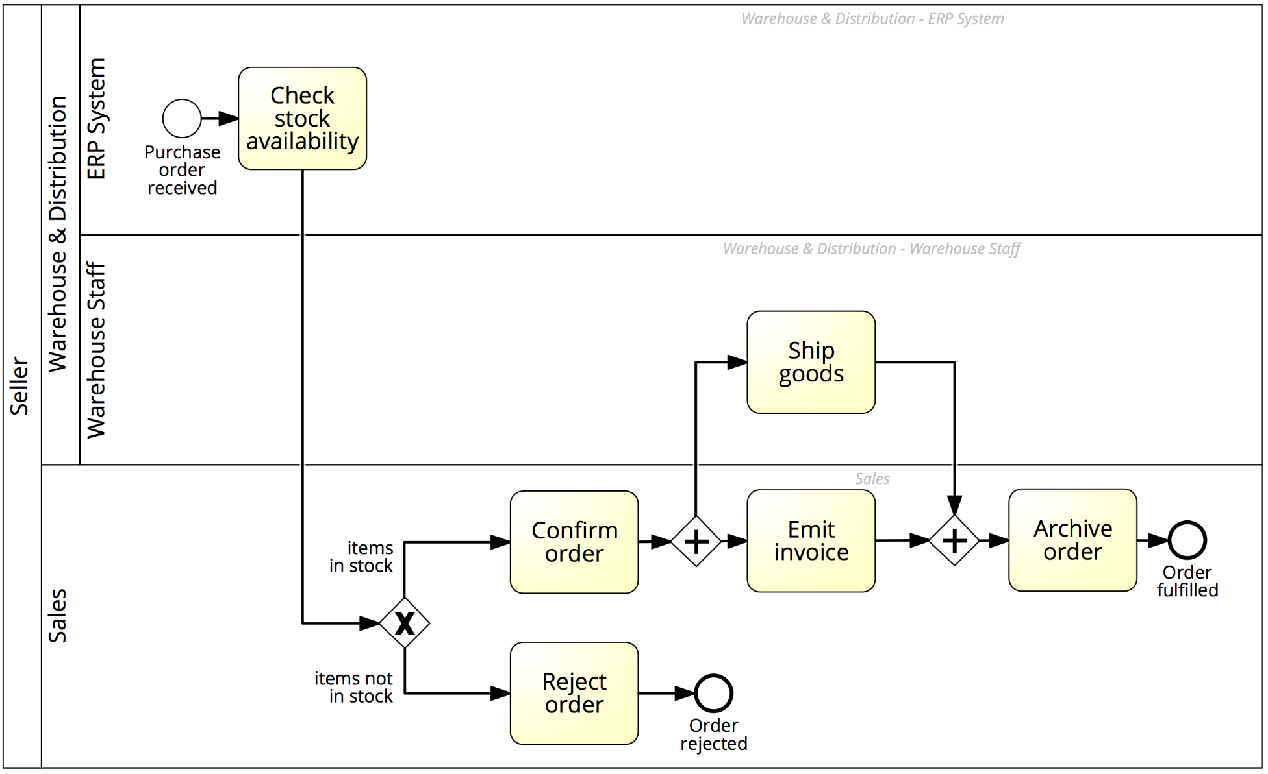
Solution
Order-to-cash

Slide 15
Exchanging information between business parties
Order-to-cash
The purchase order sent by the Customer is received by the Sales department and checked against the stock. This is done via an ERP module within the Warehouse & Distribution department. If the purchase order is not confirmed, the Sales department sends an order rejection to the Customer, otherwise it sends an order confirmation.
Next, the Warehouse & Distribution department ships the goods and sends a shipment notification to the Customer. Meantime, the Sales department emits the invoice and sends it to the Customer. The process concludes with the order being archived by the Sales department.

Slide 16
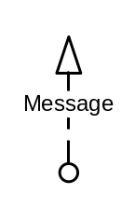

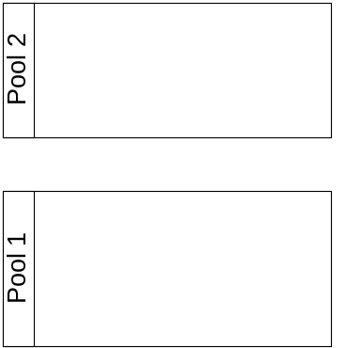
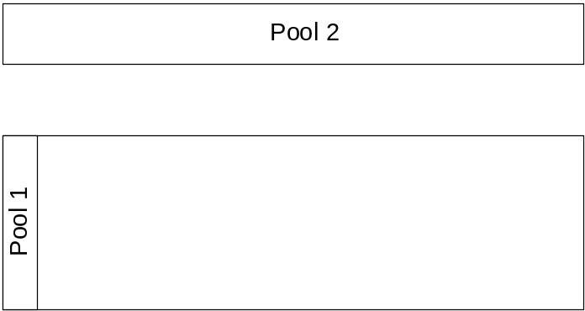
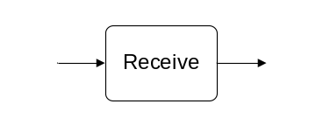

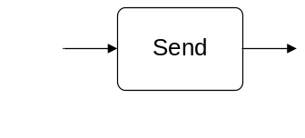
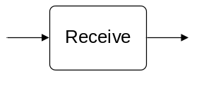
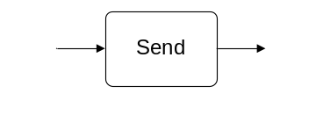
BPMN Elements – Message Flow
A Message Flow represents a flow of information between two process parties (Pools)
A Message Flow can connect:
directly to the boundary of a Pool ➔ captures an informative message to/from that party
to a specific activity or event within that Pool ➔ captures a message that triggers a specific activity/event within that party

Slide 17
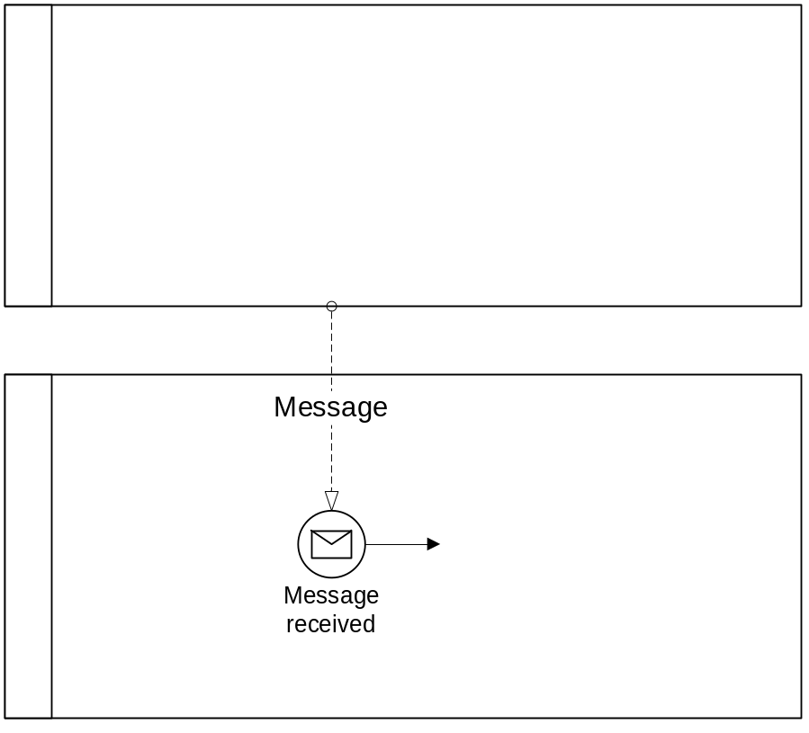
BPMN Elements – Start Message Event
The start message event triggers a process by the receipt of a message when an incoming message flow is connected to the event

Slide 18
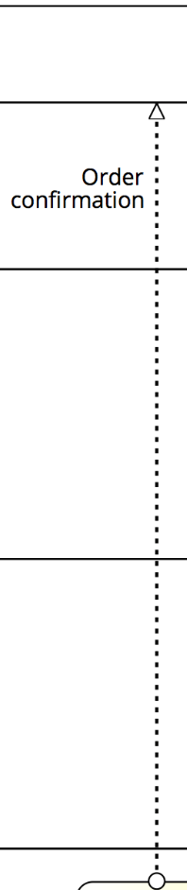

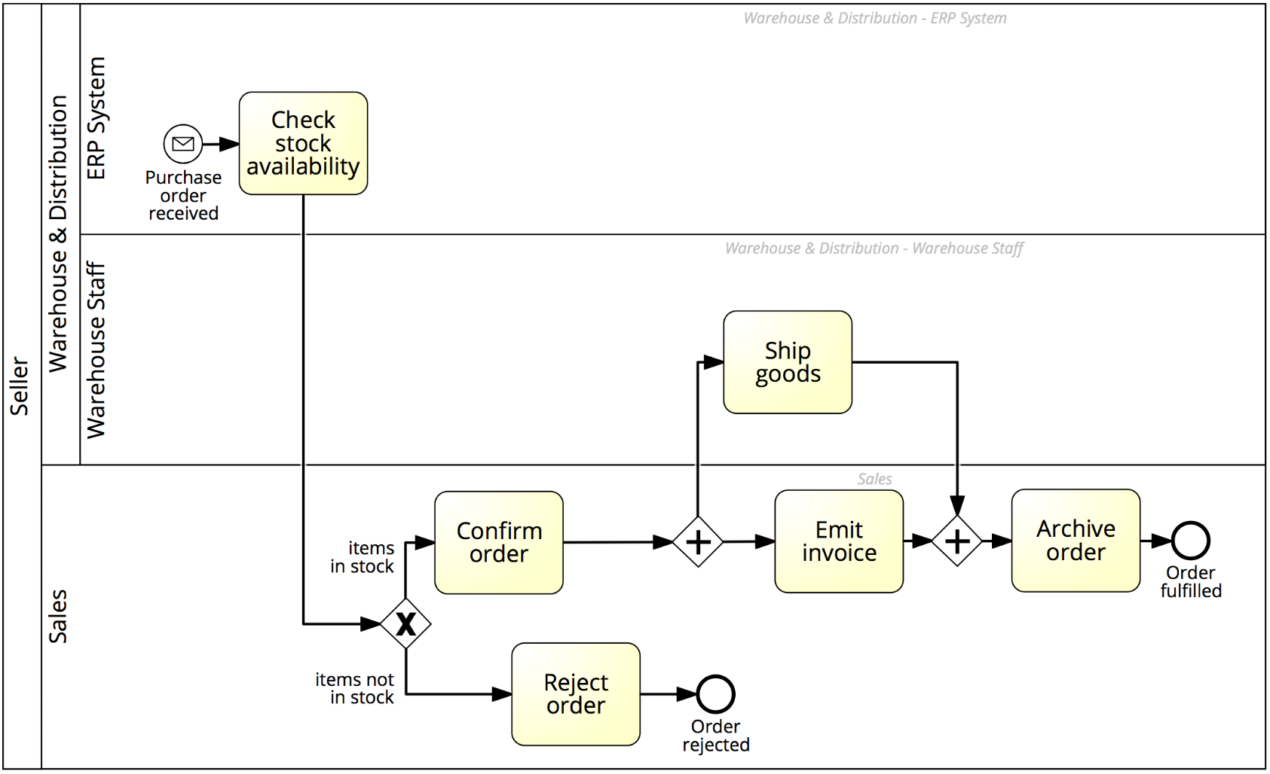
Solution
Order-to-cash

Slide 19
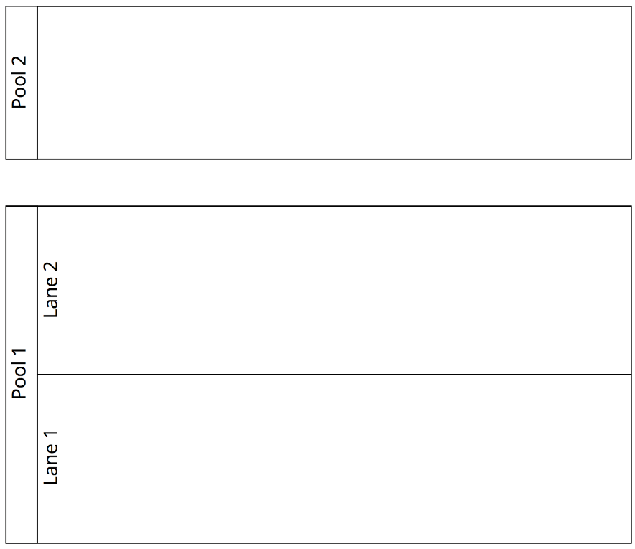

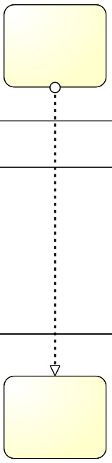
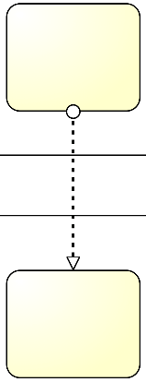


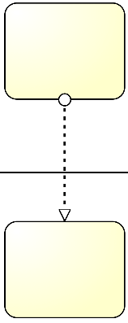
Pools, Lanes and Message Flows: syntax
The Sequence Flow cannot cross the boundaries of a Pool
Both Sequence Flow and Message Flow can cross the boundaries of Lanes
A Message Flow cannot connect two flow elements within the same pool

Slide 20

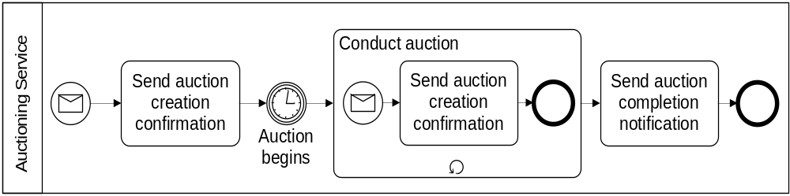
Process (or Orchestration) Diagram
  Models a single business party and can be:
  Public view (black box)
  Private view (white box)

Slide 21
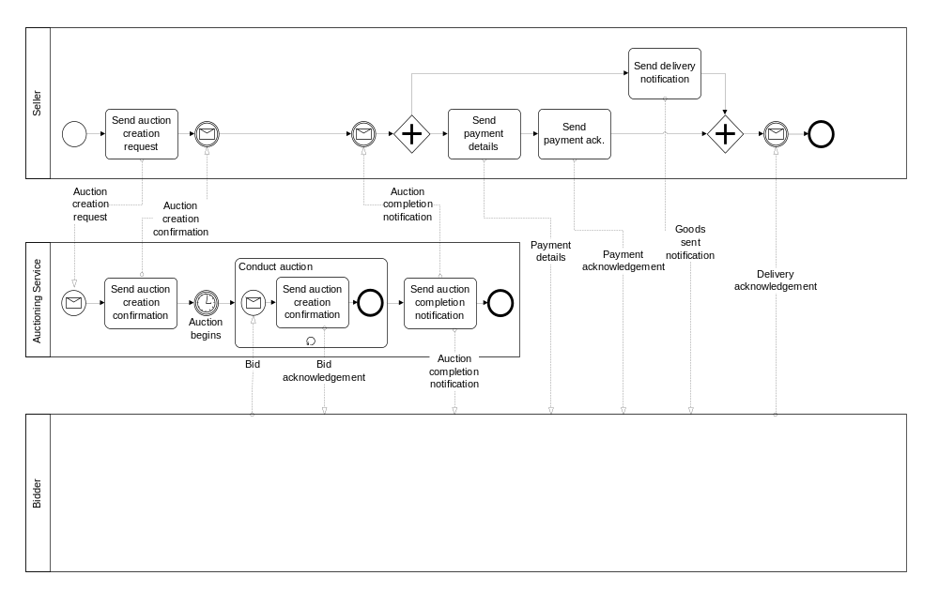
Collaboration Diagram
Models a global business process between at least two business parties (each modelled by a Pool)
Private process
Public
process

Slide 22

Readings for Week 4
Dumas M., La Rosa M., Mendling J., Reijers, H. (2013):
Fundamentals of BPM. Chapter 3: 3.3-3.5

Slide 23


Prof. Marcello La Rosa
IS School Academic Director
(Corporate Programs and Partnerships)
BPM Discipline, IS School
Science & Engineering Faculty
Queensland University of Technology
2 George Street
Brisbane QLD 4000
Australia
p +61 (0)7 3138-9482
e m.larosa@qut.edu.au
w www.marcellolarosa.com

